Slide 1
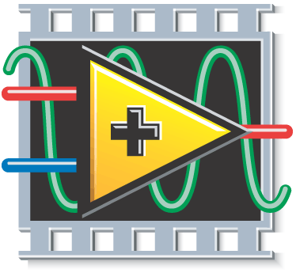
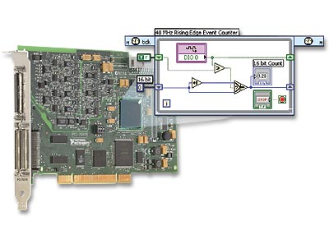
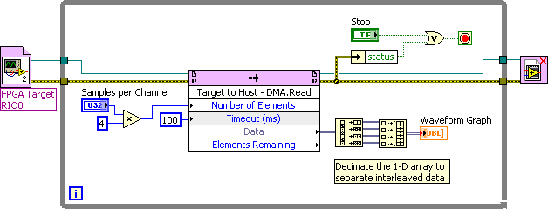

Target to Host Transfer
Data element
Buffer
read operation
Point-by-point
write operation
DMA Engine
FIFO
Local Bus
PCI Bus
Buffer
Click mouse to begin animation
Press left arrow to restart animation
Notes:
Note: Select the back arrow (on slide in lower left corner) or left arrow (keyboard) to restart animation.
DMA uses FPGA memory to store data and then transfer it at high speed to host processor memory with very little processor involvement. This uses much fewer processor cycles when sending large blocks of data compared to the front panel indicator with FPGA Read/Write method. Here are some programming tips for implementing DMA:
When setting the FPGA buffer size, you can use the default size (1023). Creating a larger FPGA memory buffer typically does not have benefits.
If you are passing an array of data, the Number of Elements input should always be an integer multiple of the array size. For example, if you are passing an array of 8 elements, the Number of Elements should be an integer multiple of 8 (such as 80, which would give 10 samples of 8 elements each.)
Each DMA transaction has overhead, so reading larger blocks of data is typically better. The DMA FIFO.Read function automatically waits until the Number of Elements you requested become available, minimizing processor usage.
Packing 16-bit channel data into a U32 (since DMA uses U32 data type) typically does not have benefits. That’s because the PCI bus has very high bandwidth for sending DMA data, so you most likely are nowhere near to using up all of the bus bandwidth. Instead, it’s typically the processor that is the bottleneck in processing the data being streamed. Packing the data in the FPGA means it has to be unpacked on the processor, adding additional processor overhead. In general, you should send each channel as a U32 even if you are acquiring 16-bit data.
The Timed Out? output on the DMA FIFO Write function is actually an error indicator. Under normal operation this should never occur so it’s recommended that you stop the application if this error occurs and reset the FPGA before restarting.

